Slide 1
TITLE SLIDE

Slide 2
INSTRUCTIONS TO STUDENTS
DRESS PROPERLY
ALWAYS KEEP THE MICROPHONE ON AND CAMERA UNMUTED
ARRANGE A COMPATIBLE INTERNET CONNECTIVITY
KEEP ALL THE ITEMS LIKE TEXTBOOK ,PEN READY
ENTER THE CLASSROOM IN TIME
PROMPTLY RETURN AFTER BREAKS
USE CHAT BOX FOR RESPONSES
QUIT IMMEDIATELY AFTER THE SESSION
PARENTS TO REMAIN PASSIVE OBSERVERS

Slide 3
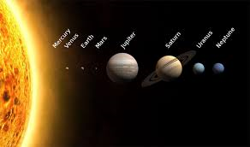
I KNOW YOUR PLANET

Slide 4
EARTH – UNIQUE PLANET
LARGE LAND MASSES - CONTINENTS
LARGE WATER BODIES - OCEANS
CONTINENTS(7)
OCEANS(5)
ASIA
NORTH AMERICA
SOUTH AMERICA
AFRICA
EUROPE
AUSTRALIA
ANTARCTICA
PACIFIC OCEAN
ATLANTIC OCEAN
INDIAN OCEAN
ARCTIC OCEAN
ANTARCTIC OCEAN

Slide 5
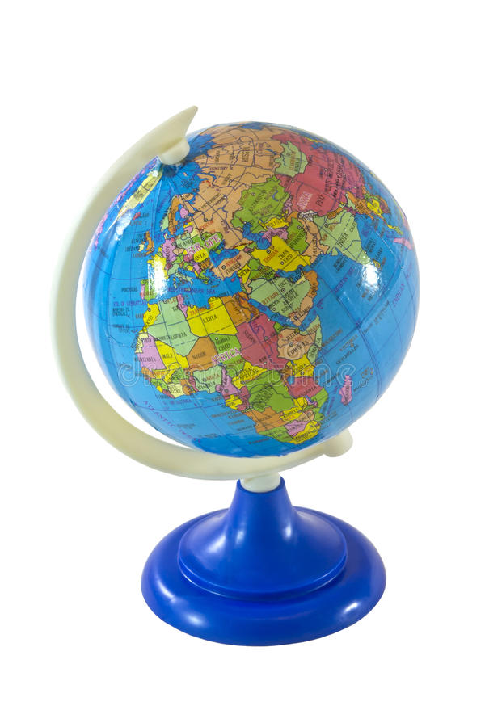
GLOBE
MODEL OF THE EARTH
IT REPRESENTS CORRECT SHAPE,SIZE AND LOCATION OF CONTINENTS AND OCEANS....
ACCURATE BUT DIFFICULT TO CARRY AND CANNOT BE USED TO REPRESENT DETAILS OF A PLACE OR ONLY A PART OF THE EARTH.
ONLY HALY PART OF THE EARTH CAN BE SEENAT A TIME ON A GLOBE.
SOCIAL STUDIES GRADE-5 /CHAPTER 1/KARUNAMBIGAI/SNS ACADEMY

Slide 6
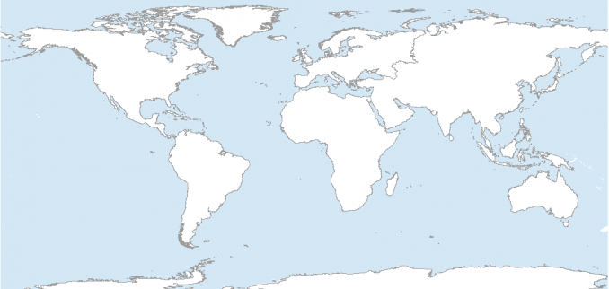
MAPS
REPRESENTATION OF THE EARTH OR A PART OF A FLAT SURFACE.
THE WHOLE EARTH CAN BE SEEN AT A TIME.
A COLLECTION OF MAPS IS CALLED AN ATLAS.

Slide 7
HOW TO READ A MAP
DIRECTION
SCALE
SYMBOLS
COLOURS
KEYS

Slide 8
WHAT IS THE SHAPE OF THE EARTH? THE COLLECTION OF MAPS IS CALLED --------------------------- - WHAT ARE THE FEATURES TO READ A MAP?
QUESTIONAIRE

Slide 9
DIFFERENT TYPES OF MAPS
PHYSICAL MAP
POLITICAL MAP
CLIMATIC MAP

Slide 10
REFERENCES & THANKING SLIDE

